Slide 1

REMOTE SENSING BASICS

Slide 2
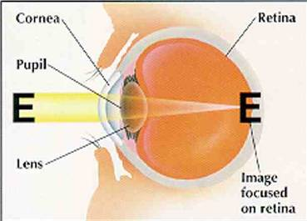
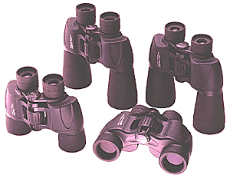
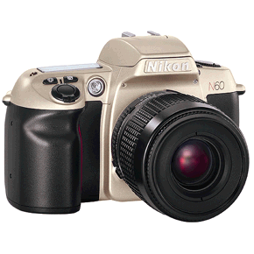
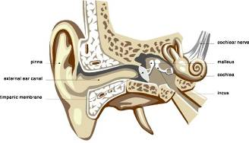
REMOTE SENSING:
The art and science of obtaining information about an object without physically contact between the object and sensor
The processes of collecting information about Earth surfaces and phenomena using sensors not in physical contact with the surfaces and phenomena of interest.
There is a medium of transmission involved i.e. Earth’s Atmosphere.
Some Remote Sensors

Slide 3
Some Remote Sensors

Slide 4
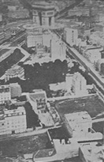
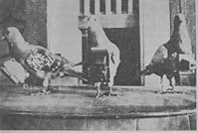
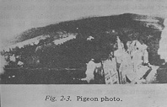
History of Remote Sensing
Balloon photography (1858)
Pigeon cameras (1903)
Kite photography (1890)
Aircraft (WWI and WWII)
Space (1947)
Images: Jensen (2000)

Slide 5
Remote sensing cycle
Remote Sensing Includes:
A) The mission plan and choice of sensors
B) The reception, recording, and processing of the signal data
C) The analysis of the resultant data.

Slide 6
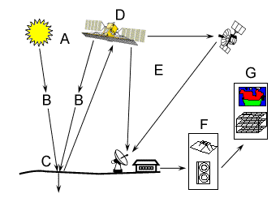
Remote Sensing Process Components
Energy Source or Illumination (A)
Radiation and the Atmosphere (B)
Interaction with the Target (C)
Recording of Energy by the Sensor (D)
Transmission, Reception, and Processing (E)
Interpretation and Analysis (F)
Application (G)
Source: Canadian Centre for Remote Sensing

Slide 7
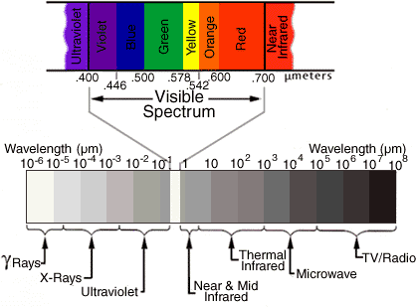
Electromagnetic Spectrum

Slide 8
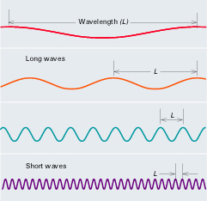
Electromagnetic Radiation

Slide 9
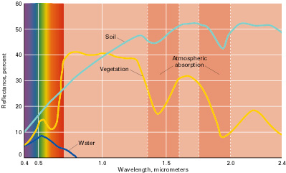
Signature Spectra

Slide 10
Fundamental term
Resolution
All remote sensing systems have four types of resolution:
Spatial
Spectral
Temporal
Radiometric

Slide 11
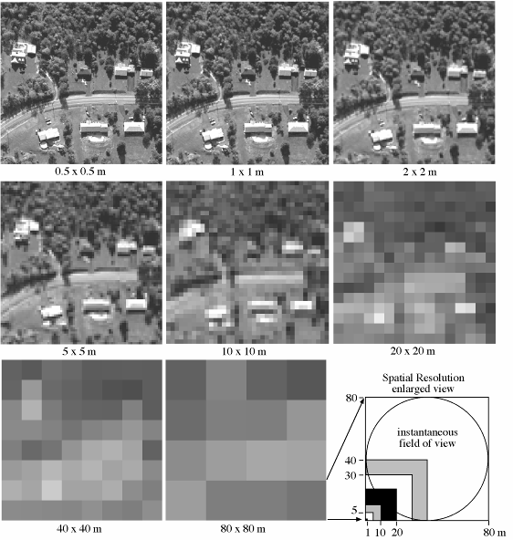
Spatial Resolution
The earth surface area covered by a pixel of an image is known as spatial resolution
Large area covered by a pixel means low spatial resolution and vice versa
High vs. Low?
Source: Jensen (2000)

Slide 12
Spectral Resolution
Is the ability to resolve spectral features and bands into their separate components
More number of bands in a specified bandwidth means higher spectral resolution and vice versa

Slide 13
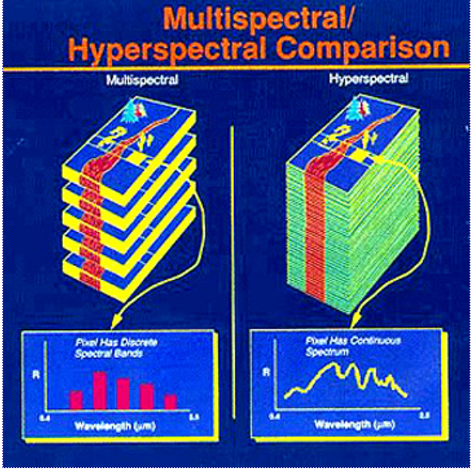
Spectral Resolution

Slide 14
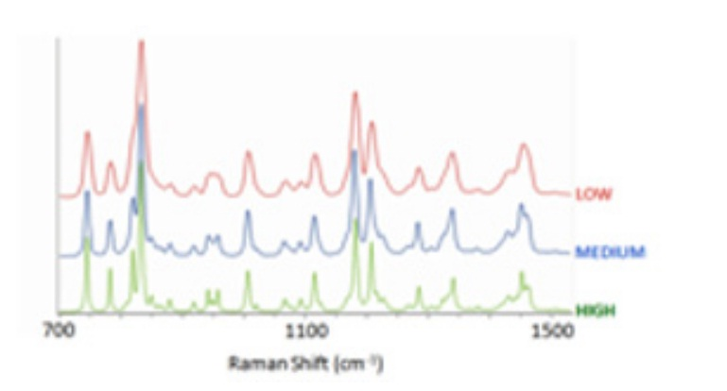
Three spectra recorded at low, medium and high spectral resolution, illustrating how the high resolution mode yields sharper peaks, and separates close lying peaks, which are merged together at low resolution
Spectral Resolution

Slide 15
Temporal Resolution
Frequency at which images are recorded/ captured in a specific place on the earth.
The more frequently it is captured, the better or finer the temporal resolution is said to be
For example, a sensor that captures an image of an agriculture land twice a day has better temporal resolution than a sensor that only captures that same image once a week.

Slide 16
Radiometric Resolution
Sensitivity of the sensor to the magnitude of the received electromagnetic energy determines the radiometric resolution
Finer the radiometric resolution of a sensor, if it is more sensitive in detecting small differences in reflected or emitted energy

Slide 17
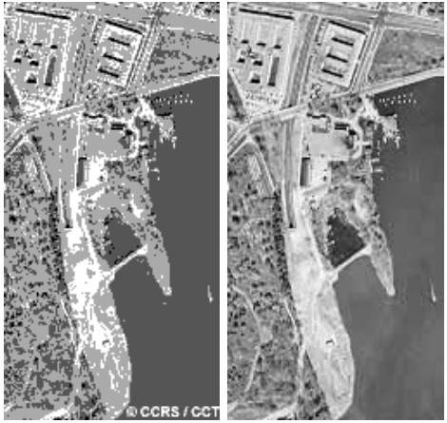
Radiometric Resolution
2-bit range
0
4
6-bit range
0
63
8-bit range
0
255
10-bit range
0
1023

Slide 18
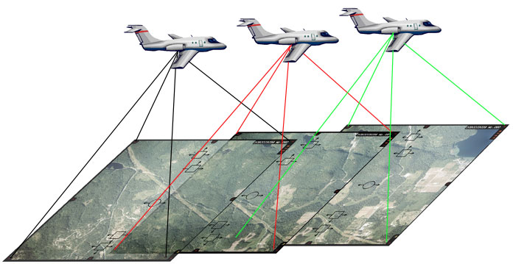
Types of Remote Sensing
Aerial Photography
Multispectral
UAVs and Drones
Active and Passive Microwave and LIDAR

Slide 19
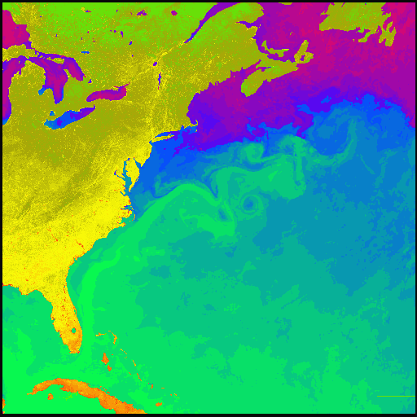
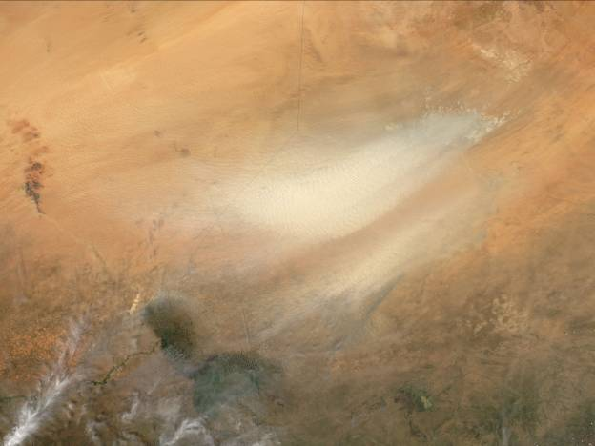
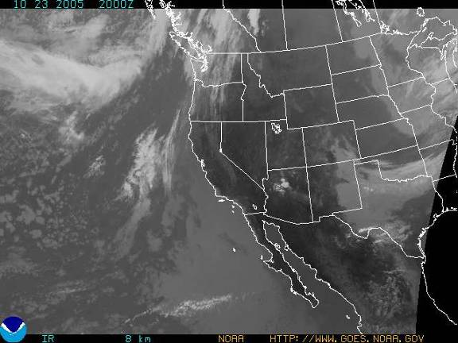
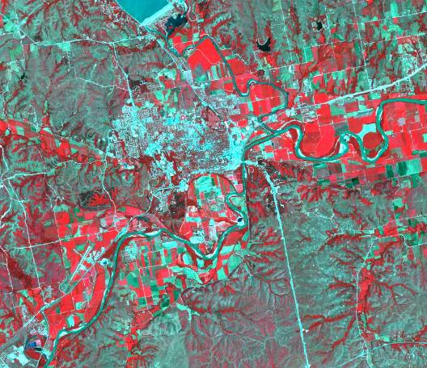
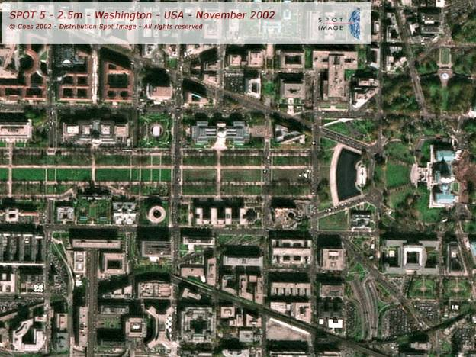
Some known satellites
NOAA-AVHRR (1100 m)
GOES (700 m)
MODIS (250, 500, 1000 m)
Landsat TM and ETM (30 – 60 m)
SPOT (10 – 20 m)
IKONOS (4, 1 m)
Quickbird (0.6 m)

Slide 20
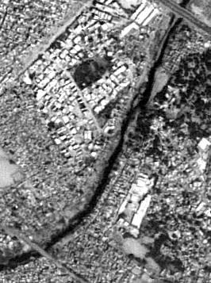
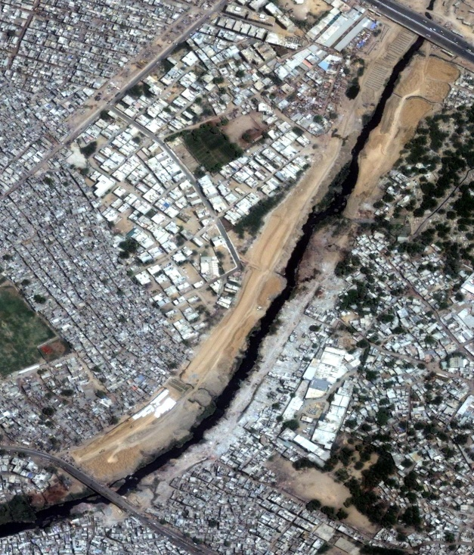
Applications of Remote Sensing
Urban & Regional Planning
Scope
Mapping & updation of city/town maps
Urban sprawl monitoring
Town planning
Facility management
GIS database development
Lyari Express Way – Section (Essa Nagri)
Benefits
Better decision support, planning & management
Rapid information updation
Infrastructure development monitoring
Spatial information analysis

Slide 21
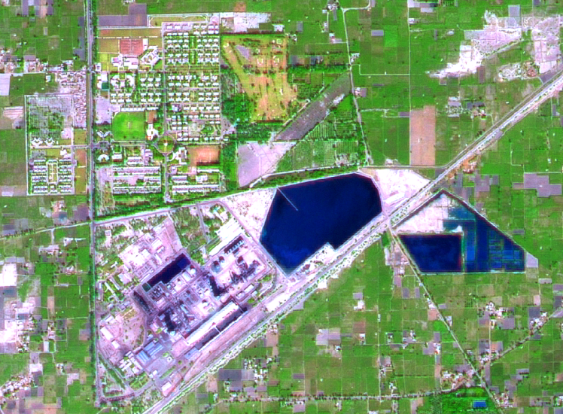
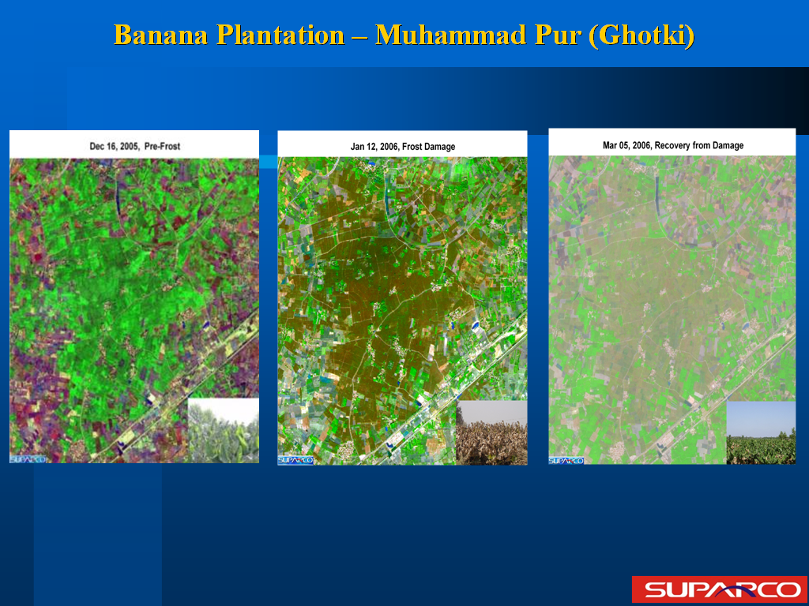
Agriculture
Scope
Crop acreage estimation
Crop modeling for yield & production forecast / estimation
Crop & Orchard monitoring
Benefits
Timely availability of crop statistics for decision making & planning
Crop growth monitoring
Soil status monitoring
Regular reports regarding total area under cultivation
FFC Goth Macchi
Dec 16, 2005, Pre-Frost
Jan 12, 2006, Damage
Mar 05, 2006, Recovery
Banana Plantation – Muhammad Pur (Ghotki)

Slide 22
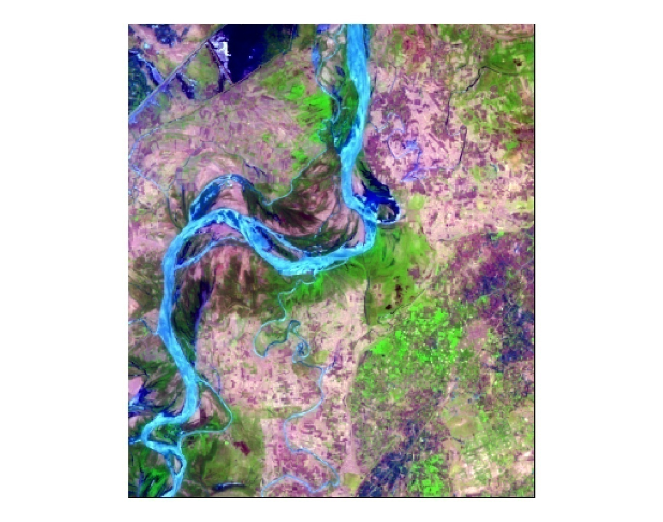
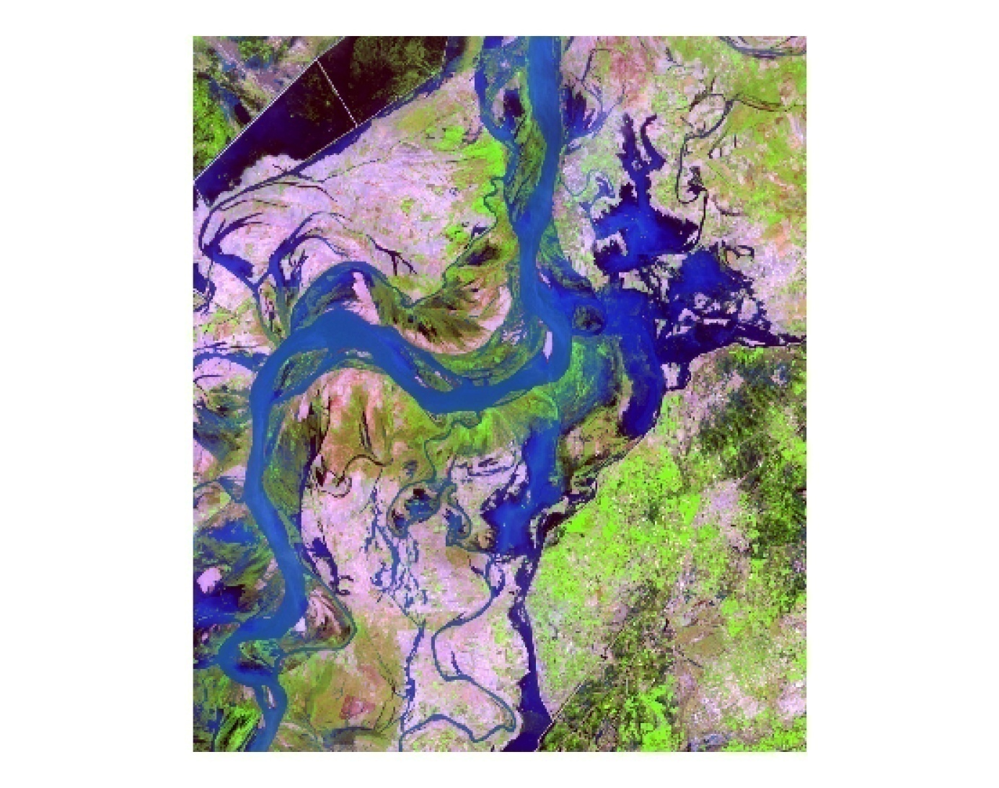
Flood Damage to Standing Crops
Pre Flood – 17 July 2006
Post Flood – 09 Aug 2006
● Muhro Mari
● Muhro Mari
● Darapur
● Darapur
● Kot Shahgarch
● Kot Shahgarch
10098 acr
● Godhpur
● Godhpur
● Phulani
● Phulani
● Than Lake
● Than Lake
● Goth Lataran
● Goth Lataran
● Shahpur
● Ural
● Shahpur
● Ural
● Junno Dhand
● Junno Dhand
● Goth Raza Mahar
● Goth Raza Mahar
● Goth Azizpur
● Goth Azizpur
3516 acr

Slide 23
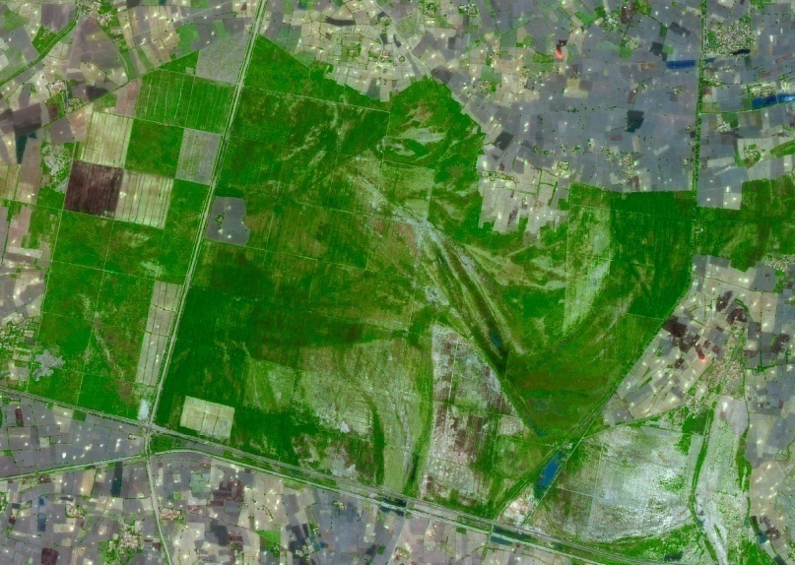
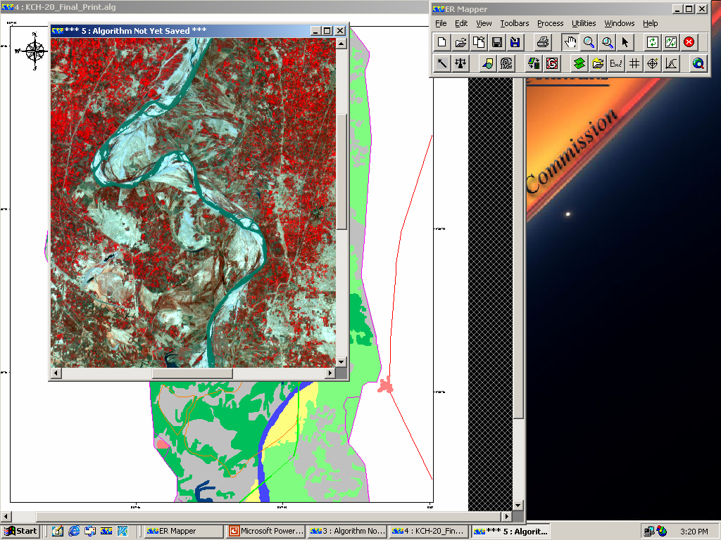
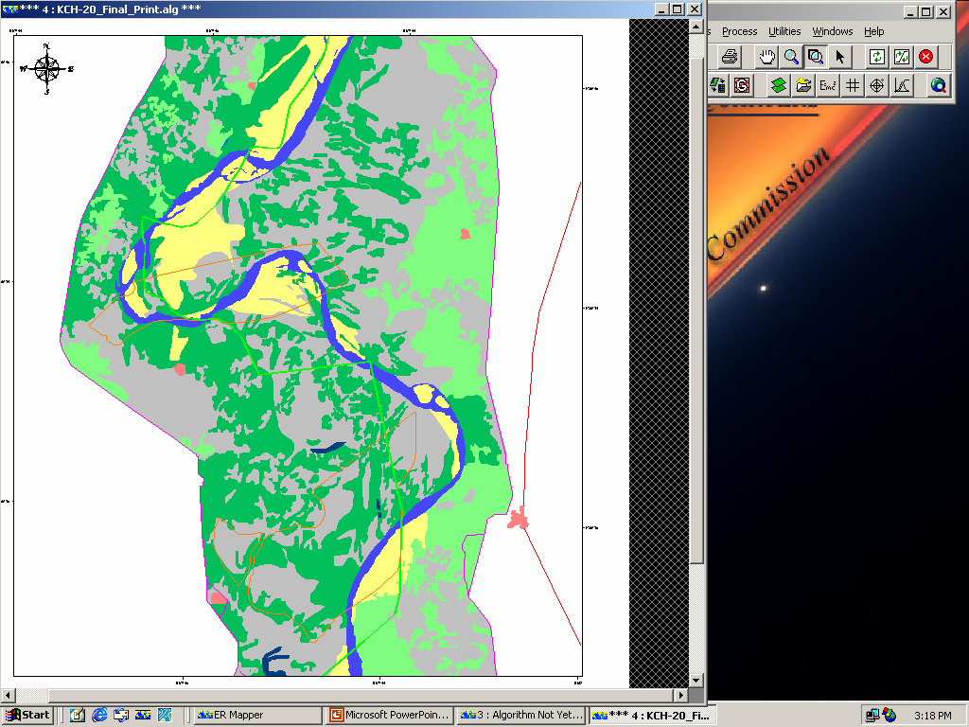
Forestry
Scope
Satellite image based forest resource mapping and updation
Forest change detection
Forest resource inventory
GIS database development
Benefits
Availability of baseline information
Planning for aforestation strategies
Futuristic resource planning
Sustainability of environment
Wild life conservation & development for recreation purpose
Sarhad Reserve Forest (Ghotki)
Nausharo
Firoz

Slide 24
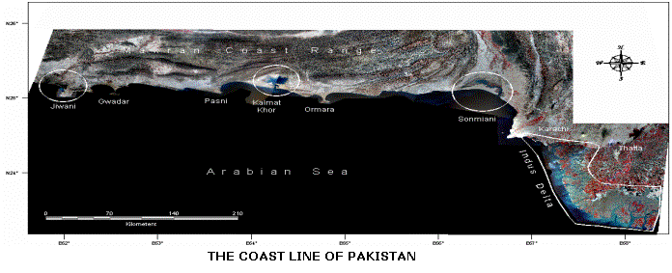
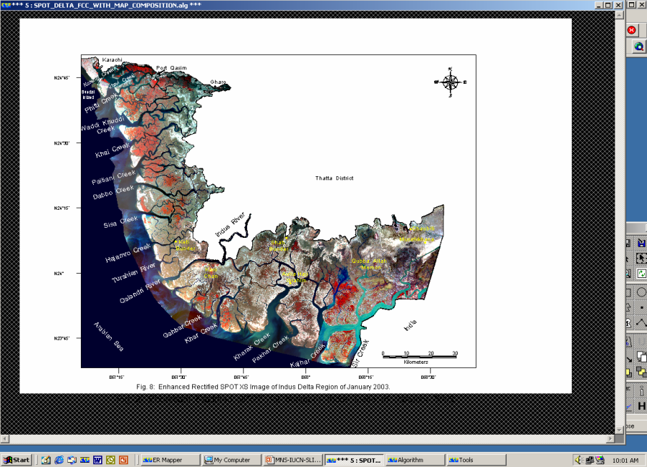
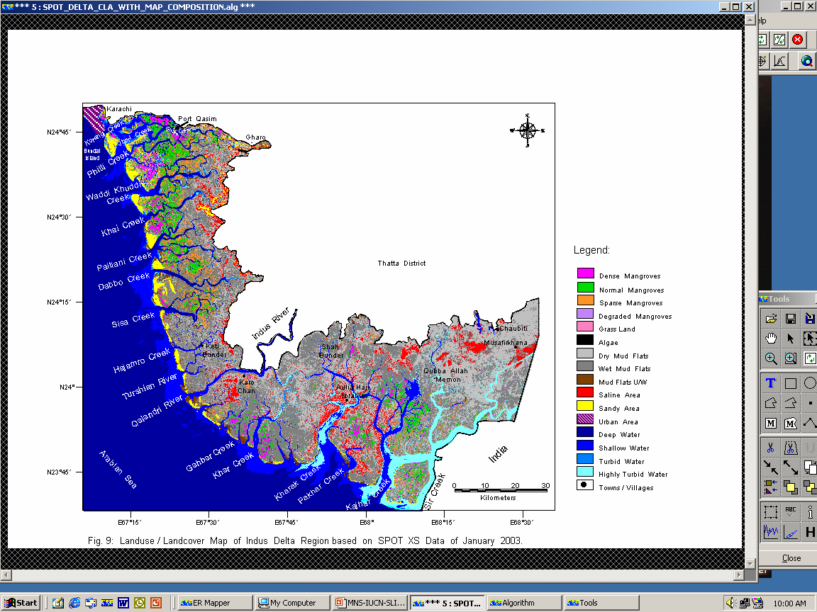
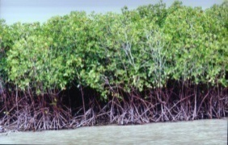
Coast Resource Mapping
Scope
Mangrove forest monitoring
Change detection
Hazard impacts
Aqua-culture zones
Benefits
Availability of updated information on mangroves forest
Planning strategies for aforestation and deforestation trend
Timely Intervention in specific areas as and when needed
Satellite image
Mangroves forest map

Slide 25
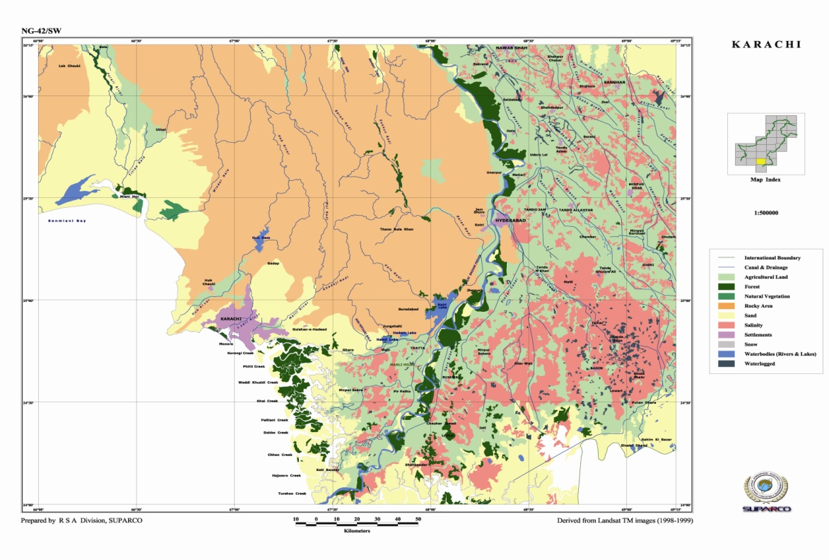
Landuse / Landcover Mapping
Scope
Monitoring dynamic changes
Urban/Rural infrastructure
Waterlogging & salinity
Benefits
Assessment of spatial distribution of land resources
Infrastructure monitoring
Availability of usable land
Future planning for better land management for socio-economic development

